Slide 1
Chapter 3
Using the Flash Recovery Area

Slide 2
Objectives
What is the Flash Recovery Area (FRA)?
Creating the FRA
Writing Backups to FRA
Space usage and the FRA
Placing redo logs (online/archived)in the FRA
Using FRA for databases with same name
Placing control file in the FRA

Slide 3
Objectives (cont.)
Sending Image copies to FRA
Deleting from the FRA
Switching files to/from the FRA
Backing up the FRA to tape
Sizing the FRA

Slide 4
The Flash Recovery Area
Used by database as backup location
  Backup sets
  Image copies
  Archivelogs
Automatically deletes unneeded backups
Can store redo logs (online/archived and control files
Optional backup area
Configure in different location than database files

Slide 5
Creating Flash Recovery Area
Factors to evaluate before creating:
  Where should it be created
  How much space should be allocated
Basic tasks:
  Disable archive destination parameters
  Run command to create the FRA:
  Alter system set db_recovery_file_dest = ‘/home/oracle/fra’
  Alter system set db_recovery_file_dest_size = 4G;

Slide 6
Writing Backups to FRA
Run backup without specifying ‘format’ option
Automatically Creates directories under FRA base:
  Database name
    Backupset (for backup sets)
    Datafile (for image copies)
    Autobackup (for control files)
    Flashback (for flashback logs)
    Archivelog
    Controlfile
    onlinelog

Slide 7


What if FRA runs out of space?
Increase space
Remove restore points (older ones)
Disable flashback

Slide 8
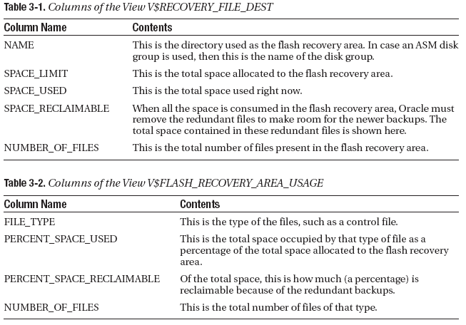
Checking FRA Space Usage

Slide 9

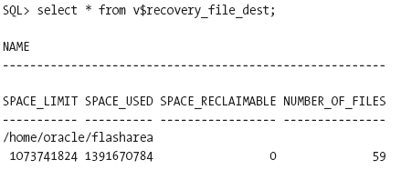
Expanding/Shrinking FRA

Slide 10
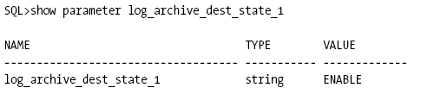
Placing Archived Logs in FRA
Use ‘alter system’:
Validate that destination is enabled:

Slide 11
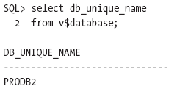
Using Same FRA for Two Databases with Same Name
First, find validate unique database name:
Then, alter initialization parameter of one database:

Slide 12
Placing Control File in FRA
Accomplished three ways:
  When database is created
  When control file recreated via SQL script when recovering from a failure
  When control file is restored from backup
Then, reflect in initialization parameter file:
  Via control files parameter
  Via db_create_file_dest parameter
    Validate that db_create_online_log_dest_[12] not used

Slide 13
Placing Online Redo Logs in FRA
Can be done at database creation via parameters:
Can be done when adding a group
  Make sure db_recovery_file_dest is set
  Make sure db_file_create_dest is NULL
  Make sure db_create_online_log_dest_* are NULL
  Issue statement to add logfile group:

Slide 14
Sending Image Copies to FRA
Two easy steps!
  Ensure flash recovery area is configured
  Ensure RMAN script has no ‘format’ command in channel configuration

Slide 15
Deleting from the FRA
For backup sets:
  First, get list of backups with ‘list backupset’ command
  Issue ‘delete backupset; command:
For archive logs:
  First, get list of backed up logs with ‘list archivelog all’ command
  Issue ‘delete archivelog command’:

Slide 16
Reinstating Damaged Datafile
Check files of database with ‘report schema’
Follow steps to recover file:

Slide 17
Switching Back from Image Copy
Check files of database with ‘report schema’
Follow steps to switch file back:
  Remove original OS file, if present
  Backup copy of file
  Take the datafile offline
  Issue ‘switch datafile’ command for that datafile
  Issue ‘recover datafile’ command for that datafile
  Bring datafile back online
  Check location once again with ‘report schema’

Slide 18

Backing up the FRA to Tape
Done via ‘backup recovery area’ command:

Slide 19
Sizing the FRA
Files to be concerned with:
  Copy of all datafiles
  Incremental backups, if configured
  Flashback logs (if enabled)
  Online redo logs
  Archived redo logs not backed up to tape
  Control files
  Controlfile autobackups

Slide 20
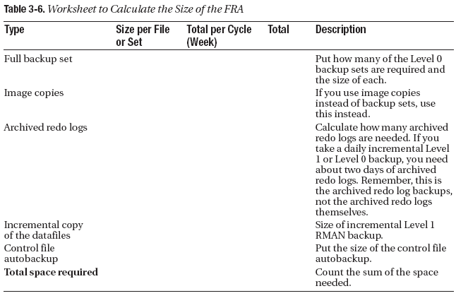
Sizing the FRA (cont.)

